Slide 1
A Distinguished Kiwanis Club Serving the communities of: Crestwood-Sunset Hills-Sappington-Concord-Green Park Club Website: www.cshkiwanis.org About Kiwanis Kiwanis is a global organization of volunteers dedicated to changing the world, one child and one community at a time
The Rewards
One act of kindness can change the course of a life. Providing that one can make a difference, Kiwanians have helped eradicate diseases, build schools, shelter the homeless, feed the hungry and generate millions of smiles.
Kiwanis is the place for you, if you –
Believe children are our future
Take pride in your community
Want to reach out to those in need
And enjoy meeting people
Because Kiwanis members are –
Strengthening communities
Building enduring friendships
Improving the lives of children
Participating in fun and fellowship
Sharpening their leadership skills
Gaining insight into local and international issues
Attaining a greater appreciation for their talents and skills
Kiwanis One
Are YOU the one?
A typical Kiwanis club is a snapshot of its community, with members from all walks of life. But Kiwanians are unified in their belief that children and their communities benefit from the efforts of a proficient group of caring and involved volunteers.
Please visit our club!!!!
Kiwanis Club of Crestwood-Sunset Hills
Meets @ 12:15 for lunch on Thursdays
Rich & Charlie’s Restaurant
9942 Watson Road
St. Louis, MO 63126
Contact: Deborah Rhodes at
314–223-5264

Slide 2
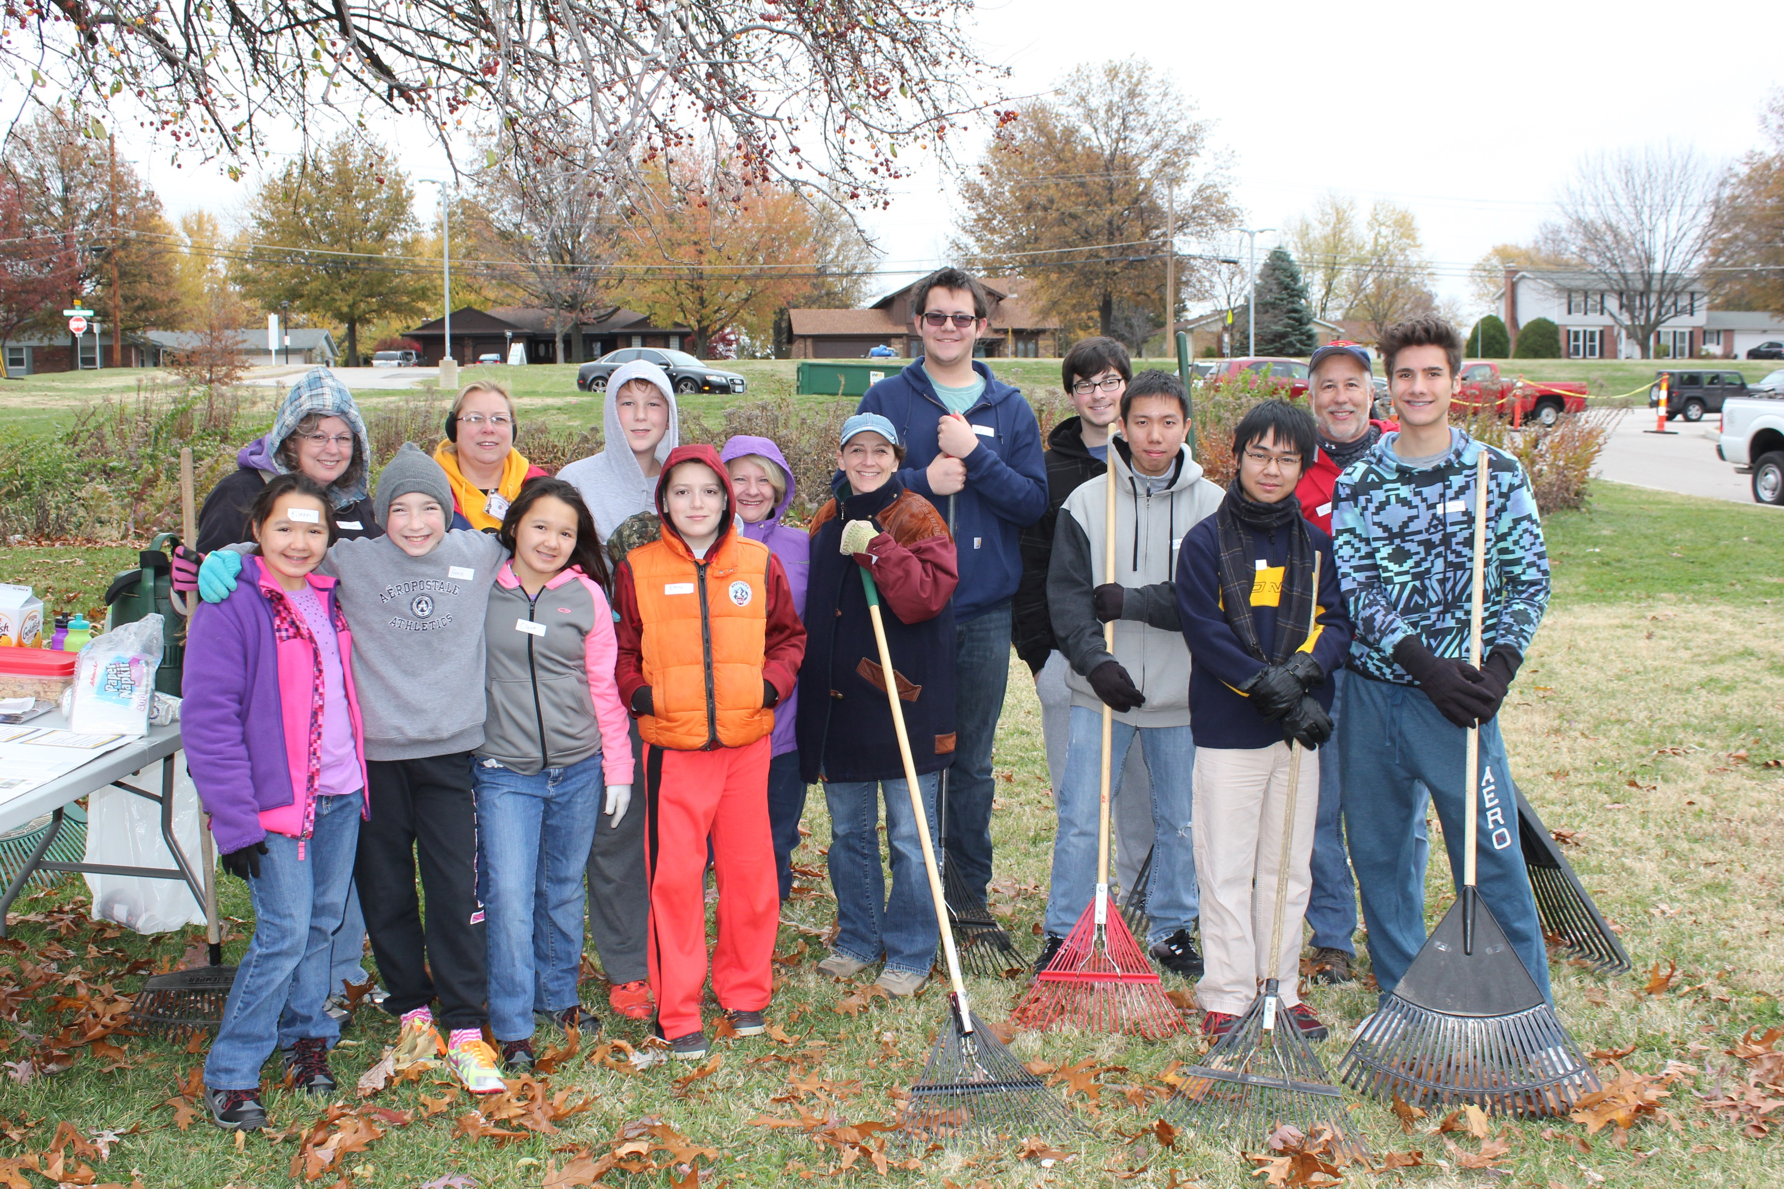
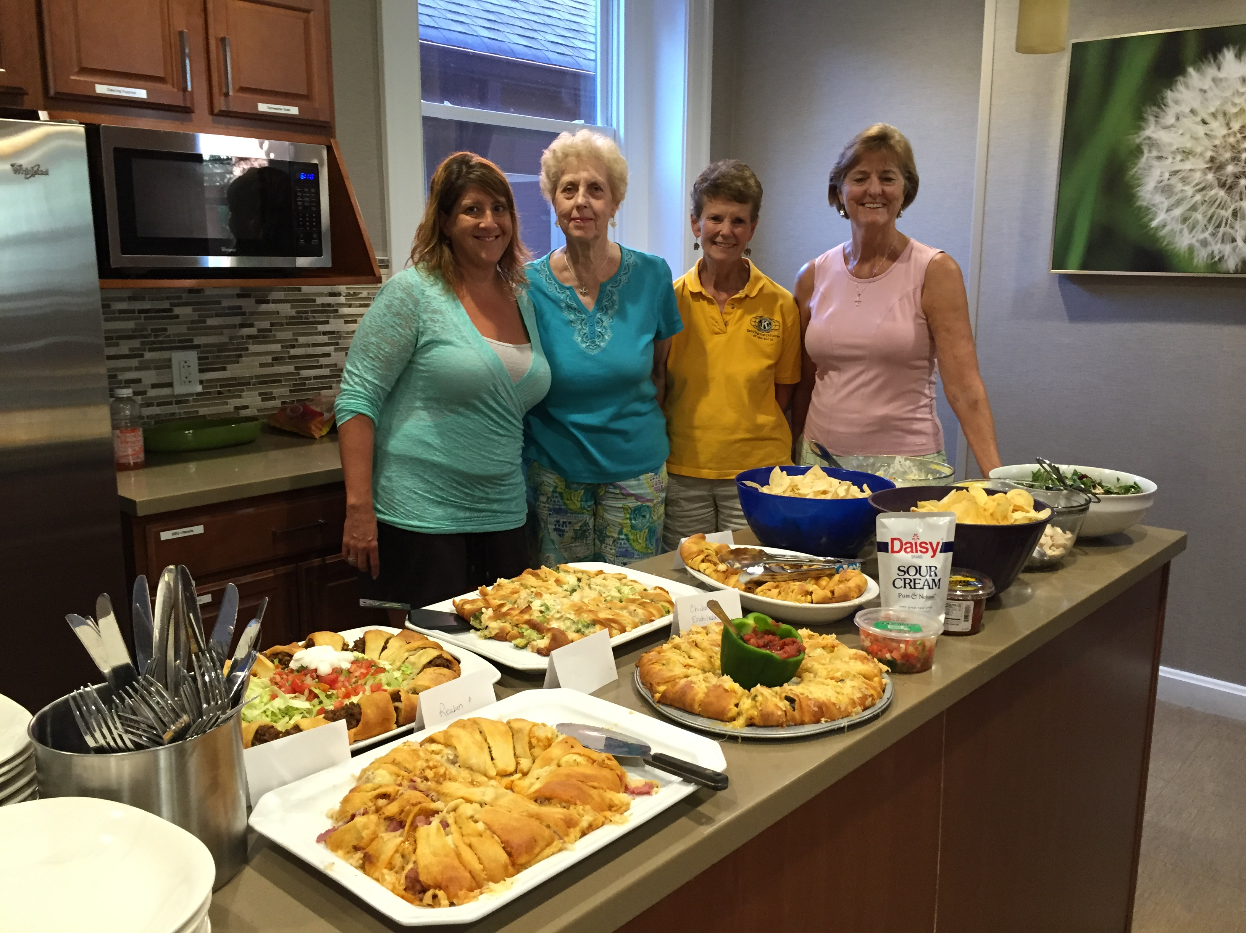
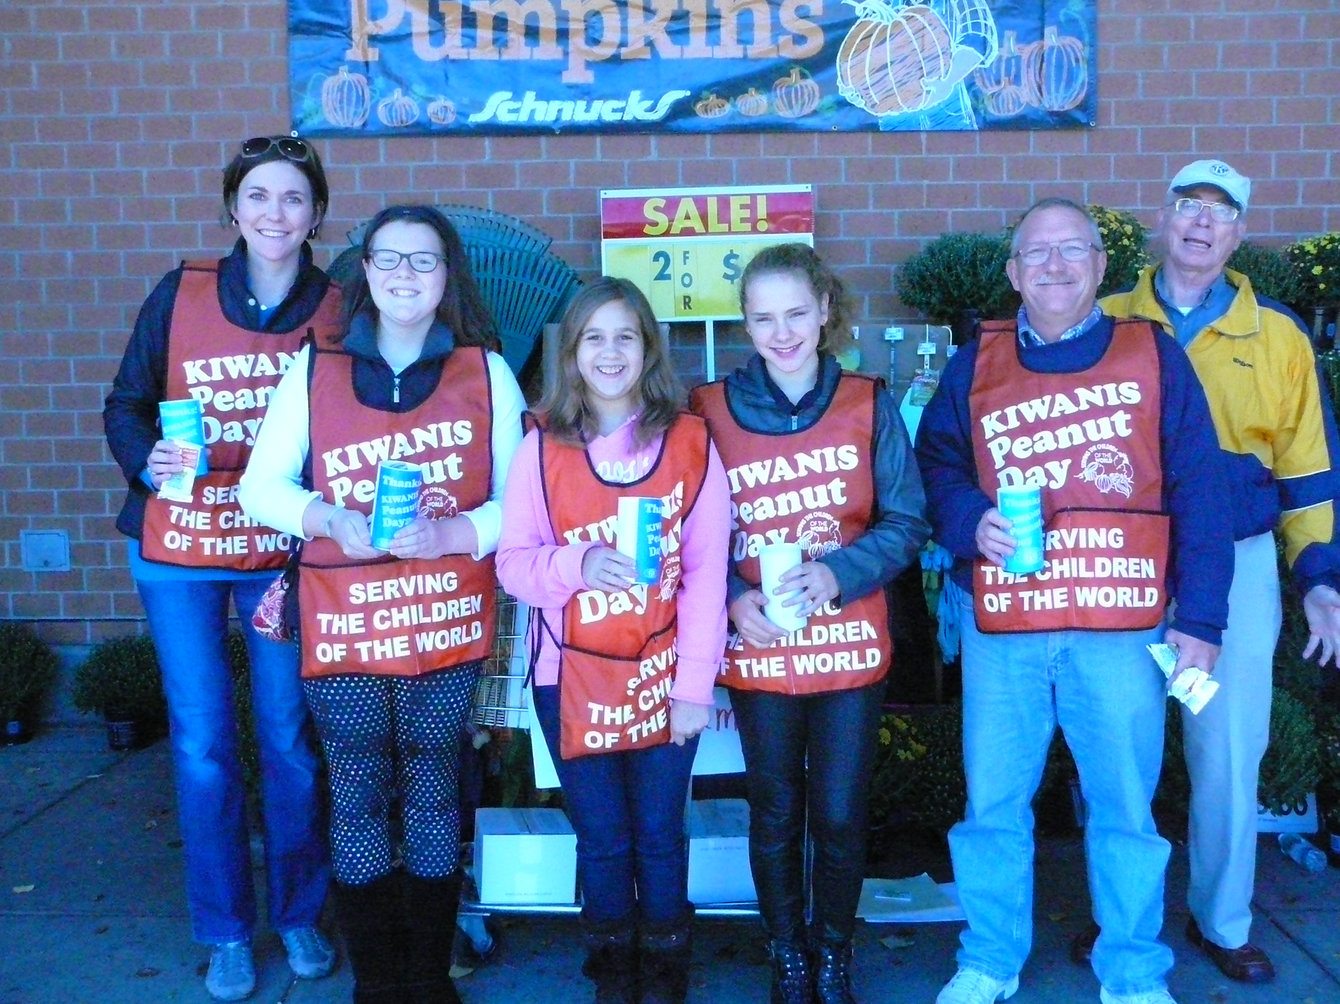
Crestwood-Sunset Hills Kiwanis Club Chartered in 1963 Region 4 MO-ARK District Division 9 Serving the Children of the World The Tradition In 1915, Kiwanis International was founded in Detroit, Michigan by Allen S. Browne, a professional organizer, and Joseph C. Prance, a tailor. Their mission was to develop an organization that provides fellowship, an experience in new ideals and community service. Now Kiwanis International has thousands of members worldwide.
Kiwanis Objectives
To give primacy to the human and spiritual rather than to the material values of life.
To encourage the daily living of the Golden Rule in all human relationships.
To promote the adoption and the application of higher social, business, and professional standards.
To develop, by precept and example, a more intelligent, aggressive and serviceable citizenship.
To provide, through Kiwanis Clubs, a practical means to form enduring friendships, to render altruistic service and to build better communities.
To cooperate in creating and maintaining that sound public opinion and high idealism which make possible the increase of righteousness, justice, patriotism and goodwill.
Local Service Activities
Key Club, Builder’s Club and K-Kids
First Responder Honors
Excellent Educator Honors
Clothing, Art Supplies, Toiletries, Toys, Food and School Supplies Collection/Donations
Father Dickson Cemetery Clean-up
Sunday Night Lights Carnival Booth
Crestwood Family Fun Fest Trunk or Treat Booth
Ronald McDonald House Monthly Food Preparation
Quarterly Roadside Clean-up
Holiday Cards for Heroes
Student of the Month Awards
Major Gifts Awards

