Slide 1
Keep your club safe! Cybersecurity tips
WELCOME

Slide 2
Keep your club safe! Cyber security tips
Presenter Name
Role

Slide 3
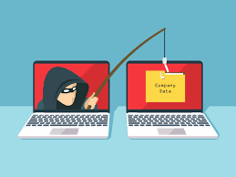
Keep your club safe! Cyber security tips

Slide 4
Cyber Security
Hackers will call your phone!
Never give out information over the phone, through email or in person unless the requestor's identity is confirmed.
Instead, call the company back via a published phone number.

Slide 5
Cyber Security
Club Website Content Tips

Slide 6
Cyber Security
If you publish personal information on your website – hackers will probably find it and use it to launch an attack!

Slide 7
Cyber Security
Never place personal information including email addresses, rosters, officer lists or district directories on your website
Never upload (PDF, Excel, Word, etc.) personal member information on your website
Use contact forms instead of email addresses on your website
Same rules apply to all social media pages like Facebook

Slide 8
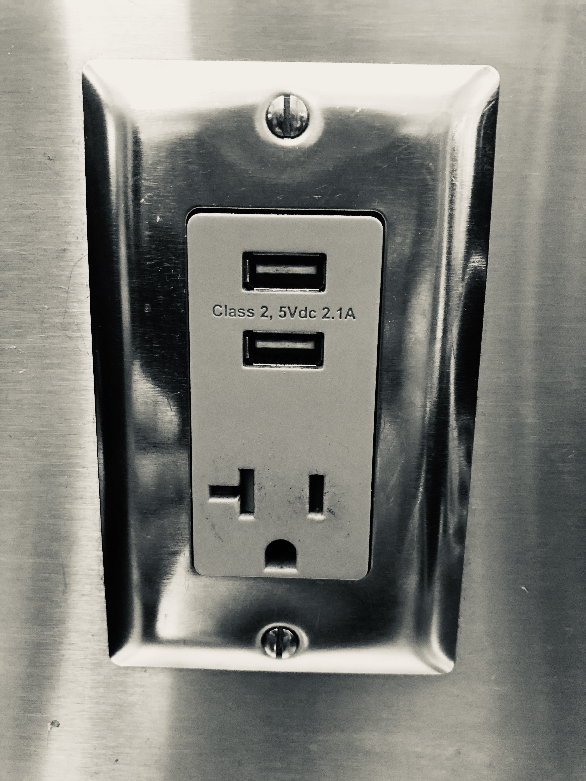
Cyber Security
Don't use airport charging stations
Data access and charging both go through the USB port so hackable
Use a portable charger instead

Slide 9
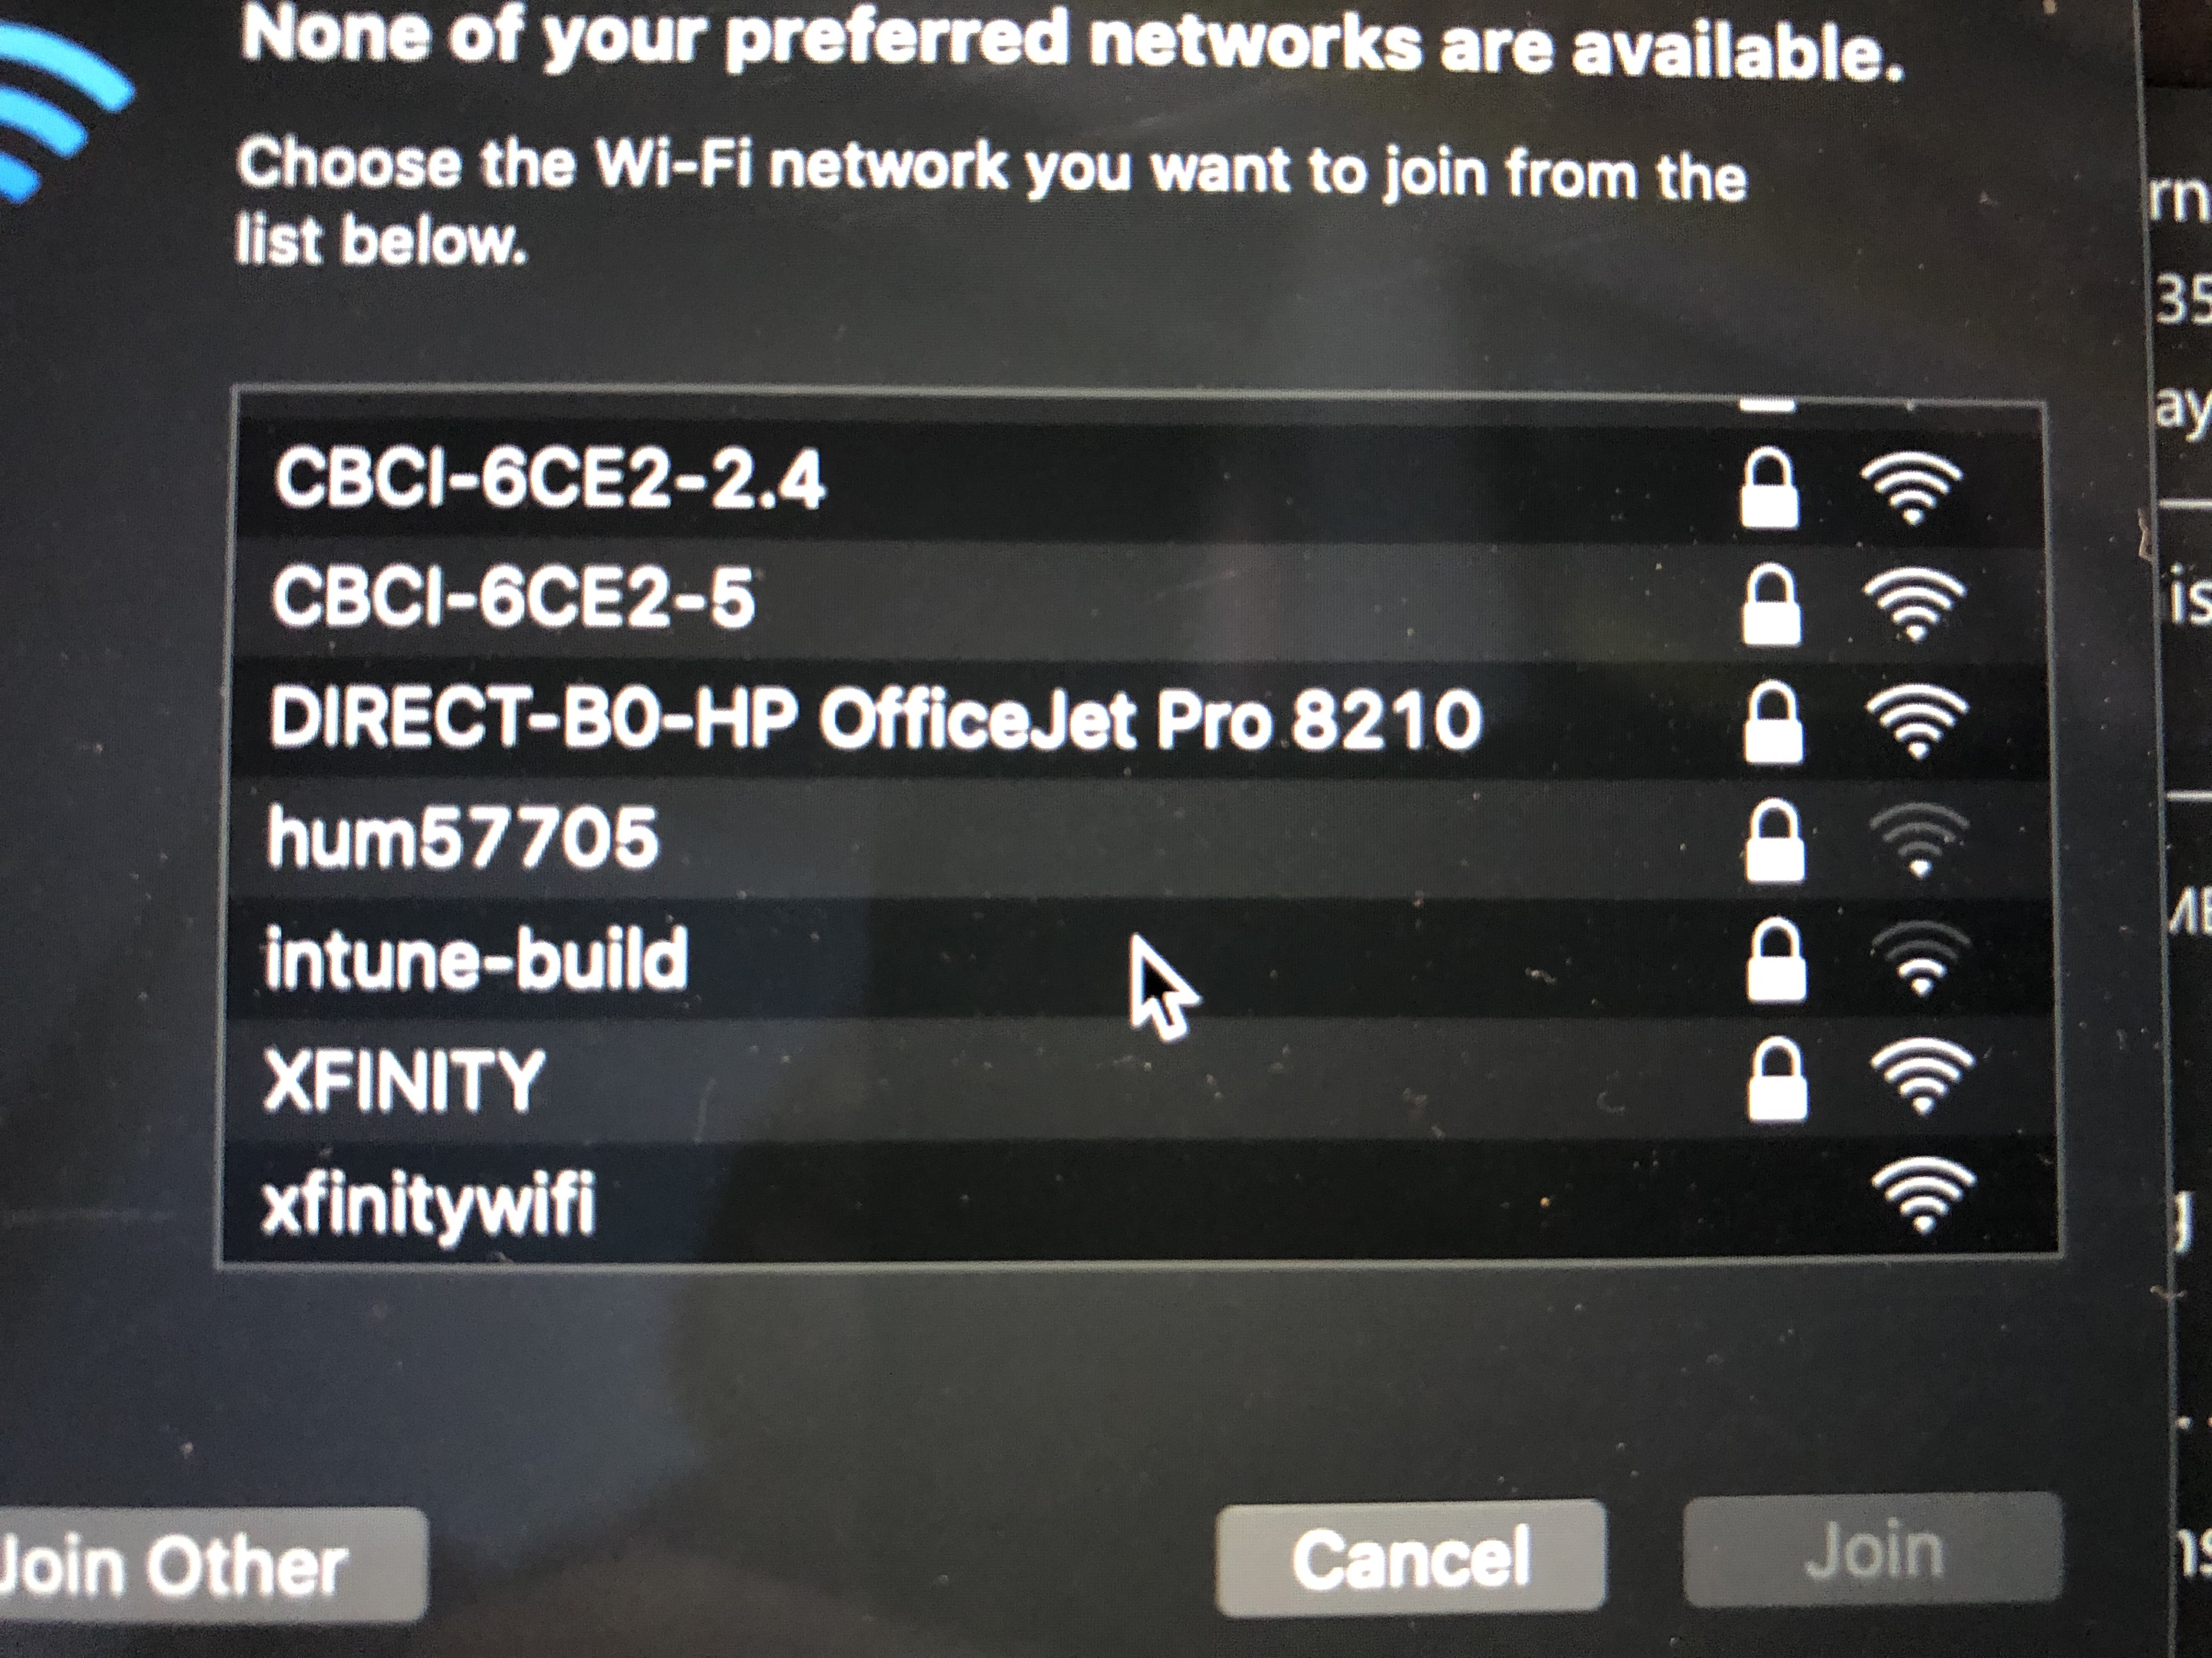
Cyber Security
Don't use untrusted wifi networks
Hackers can impersonate as a known network and then hack your device and steal your information
Use your phone hotspot instead

Slide 10
Keep your club safe! Cyber security tips
PHISHING

Slide 11
Cyber Security
Phishing
An attempt to obtain sensitive information such as
Usernames
Passwords
Contact lists
Credit card details
by masquerading as a trustworthy source

Slide 12
Cyber Security
Phishing
Often done using
Email
Instant messaging
Texting
Phone calls

Slide 13
Cyber Security
The biggest security problem online
Phishing accounts for 90 to 95% of security threats

Slide 14
Cyber Security
Phishing victims might be tricked into clicking a link through to a fake webpage.
The aim is persuading the user to enter personal information.

Slide 15
Cyber Security
A link can be in the form of a:
Text link
Button link
Image link

Slide 16
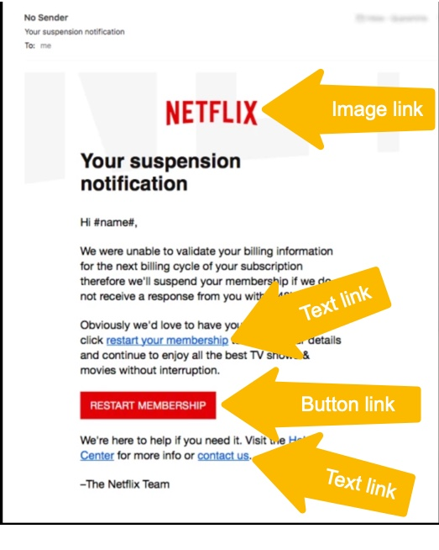
Cyber Security
Example of a Netflix Phishing email

Slide 17
Cyber Security
It's estimated that an average of 1.4 million phishing websites are created
every month.

Slide 18
Cyber Security
Some victims are tricked into downloading and installing malware including ransomware and spyware

Slide 19
Cyber Security
Some Definitions
Malware – Any malicious software used to exploit and do harm to a computer, computers or a network.
Ransomware – A malware that holds computer files hostage until ransom paid.
Spyware – A malware that records keystrokes and user activity and sends data to the hacker for exploitation.
Social Engineering - Art of manipulating, influencing, deceiving you to take action not in your or your business' best interest.

Slide 20
Cyber Security

Slide 21
Cyber Security
Common Phishing techniques include offers of prizes won in fake competitions such as lotteries or contests by retailers offering a 'discount code' or a 'giveaway prize'.

Slide 22
Cyber Security
In order to 'win' the prize, the victims are asked to enter their details such as name, date of birth, address and bank details in order to claim. But there's no prize, and all they've done is put their personal details into the hands of hackers.

Slide 23
Cyber Security
Phishing attempts claim to be from popular retail, social, government, banks and auction websites – attempting to trick the unsuspecting person.

Slide 24
Cyber Security
Spear Phishing
Key individual(s) or organization are targeted to gain valuable information other than credit card data.
Targets are researched to make the attack more personalized and increase chances of success.
Phishers gain trust, then exploit that trust to gain information or access.

Slide 25
Cyber Security
Spear Phishing attempts claim to be from friends, coworkers, your HR department, your IT administrator – attempting to lure the unsuspecting person through a false sense of trust.

Slide 26
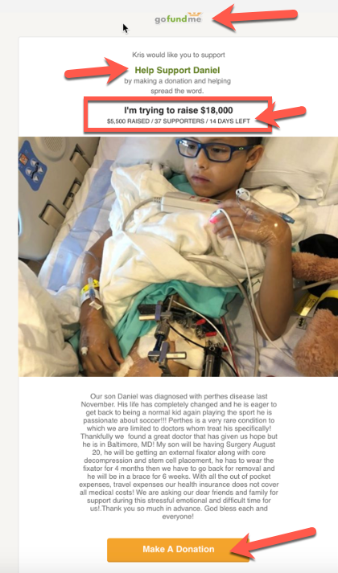
Cyber Security
Actual Spear Phishing Attack on a Kiwanis District
Appeared to come from Governor
Sent to members in the district

Slide 27
Cyber Security
How did the hackers do it?

Slide 28
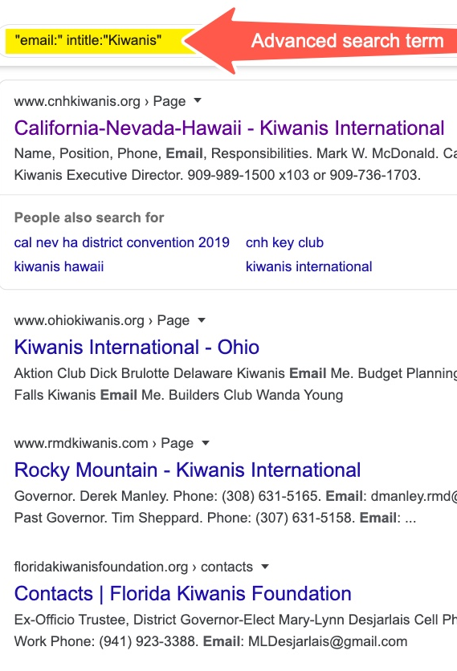
Cyber Security
Advanced Search in Google

Slide 29
Cyber Security
This search returns any pages that mention "email:" and have "Kiwanis" in the page title.

Slide 30
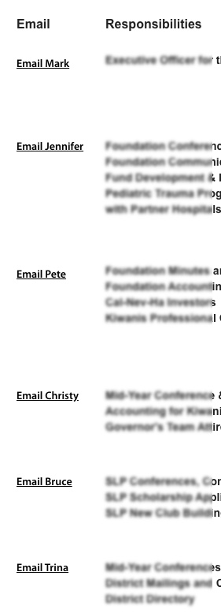
Cyber Security
Attackers now have what they need to launch a Spear Phishing attack!

Slide 31
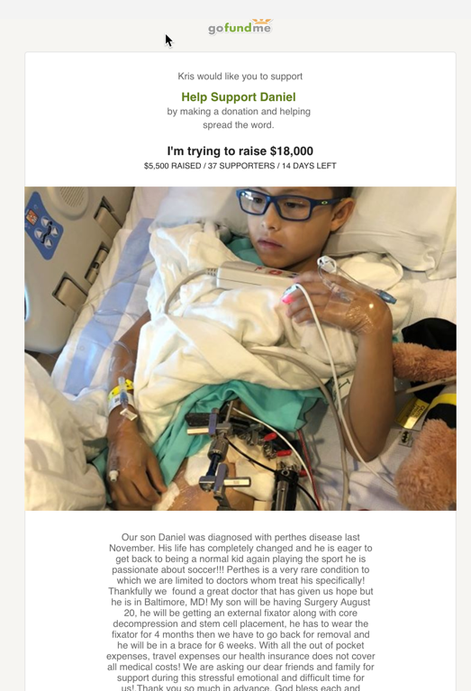
Cyber Security
Next, the attacker creates an email that resonates with Kiwanians and sends it out, impersonating a Kiwanian.

Slide 32
Cyber Security
How can I keep from
becoming a victim of Phishing?

Slide 33
Cyber Security
Look for RED FLAGS.
Reg flags warn you to STOP.

Slide 34
Cyber Security
Red Flags of Phishing emails
Phishing emails cause an emotional response
They create urgency – act NOW!
They may carry a threat – something bad will happen if you don't act NOW.

Slide 35
Cyber Security
Red Flags of Phishing emails
They appear to be from a trusted source
Make promises too good to be true
Contain links and direct you to click these links
Often contain malicious malware attachments
Often contain typos

Slide 36
Cyber Security
RED FLAGS – What to look for
First of all, STOP and THINK

Slide 37
Cyber Security
Anatomy of an email
"From:" line

Slide 38
Cyber Security
Anatomy of an email
"From:" line
"To:" line

Slide 39
Cyber Security
Anatomy of an email
"From:" line
"To:" line
"Subject:" line

Slide 40
Cyber Security
Anatomy of an email
"From:" line
"To:" line
"Subject:" line
Date & time sent

Slide 41
Cyber Security
Anatomy of an email
"From:" line
"To:" line
"Subject:" line
Date & time sent
Content

Slide 42
Cyber Security
Anatomy of an email
"From:" line
"To:" line
"Subject:" line
Date & time sent
Content – Links (text, images and buttons)

Slide 43
Cyber Security
Anatomy of an email
"From:" line
"To:" line
"Subject:" line
Date & time sent
Content – Links & attachments

Slide 44
Cyber Security
RED FLAGS – What to look for
"FROM:" line
From an unknown address
If you know the sender but the email is unexpected or out of character

Slide 45
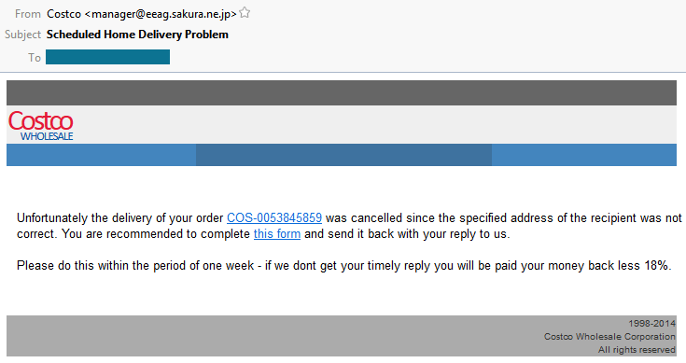
Cyber Security

Slide 46
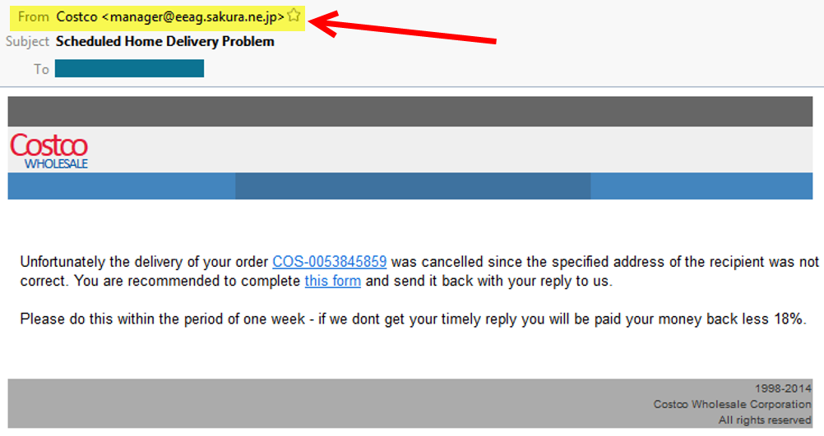
Cyber Security

Slide 47
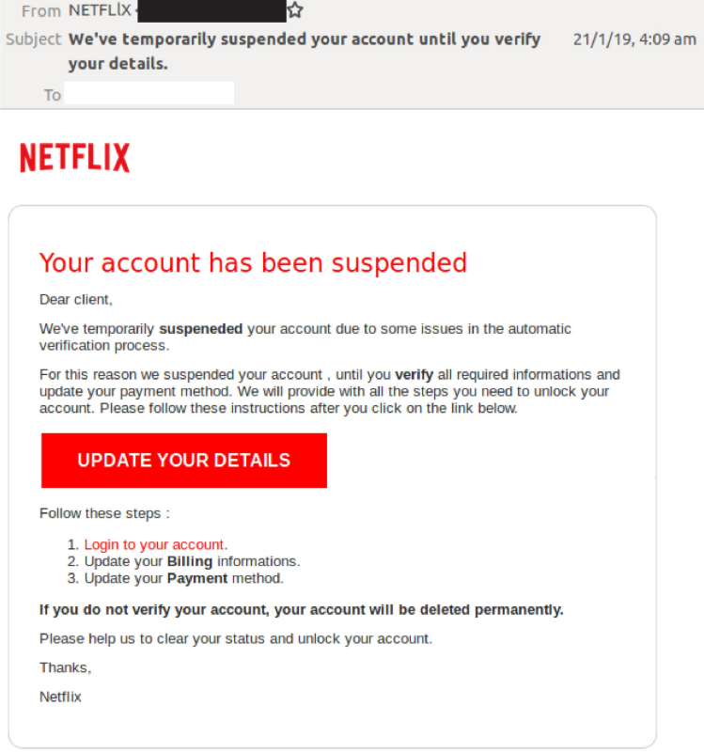
Cyber Security

Slide 48
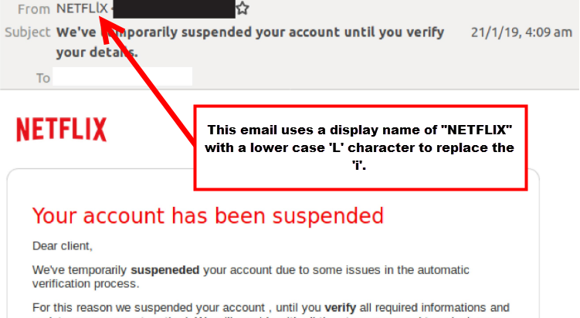
Cyber Security

Slide 49
Cyber Security
To: line
You were copied on an email and you don’t know the other people it was sent to.
A generic greeting is used – not your name.

Slide 50
Cyber Security
Date: line
Receive an email you would normally get during normal business hours, but it was sent at 3 a.m.

Slide 51
Cyber Security
Subject: line
The subject line of an email is not relevant or doesn't match the message content.
An email about something you never requested or a receipt for something you never purchased.

Slide 52
Cyber Security
Content of email
Sender is asking you to click on a link or open an attachment to avoid a negative consequence
You have an uncomfortable feeling, or it just seems odd or not logical.

Slide 53
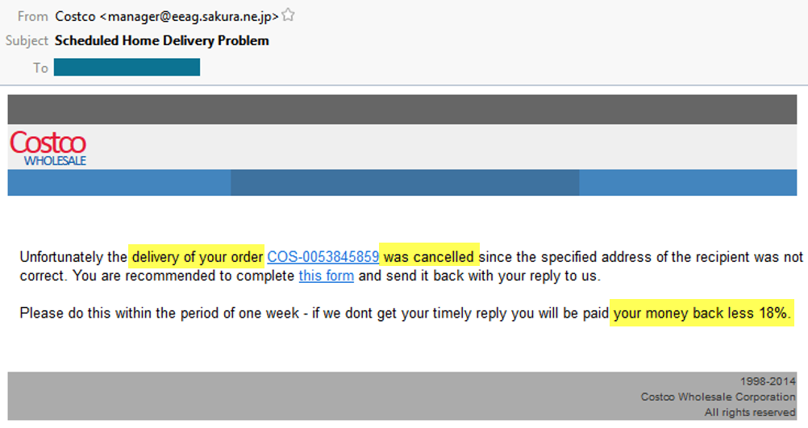
Cyber Security

Slide 54
Cyber Security
The email is deliberately trying to get an emotional response from you.
Good or Bad

Slide 55
Cyber Security
Hyperlinks (links)
Look for misspellings
Email contains hyperlinks asking you to take an action
Text, images and buttons can contain malicious hyperlinks

Slide 56
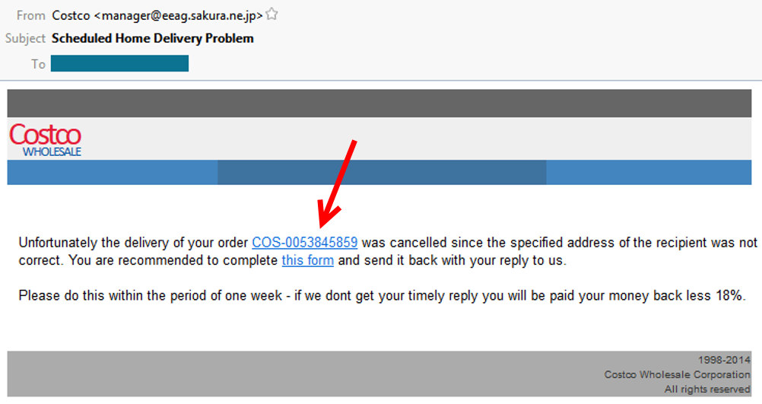
Cyber Security

Slide 57
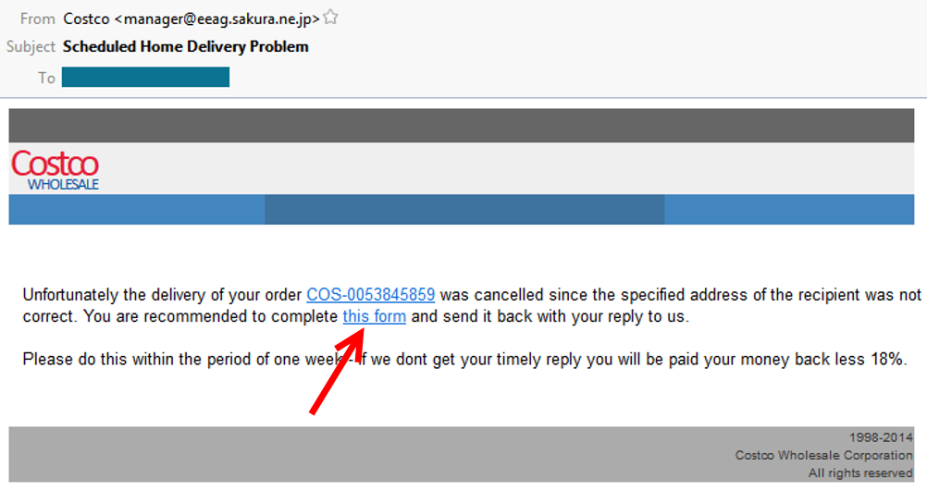
Cyber Security

Slide 58
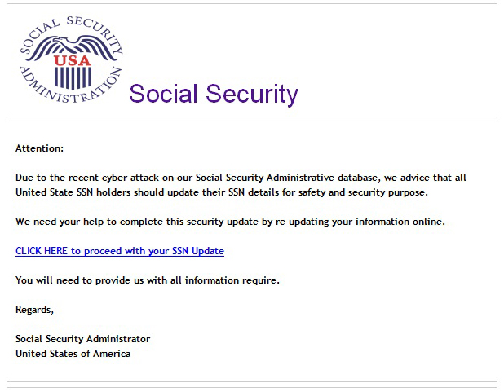
Cyber Security

Slide 59
Cyber Security
OH NO!
My Social Security profile has been record has been hacked!!!
I have to CLICK the link and FIX it!

Slide 60
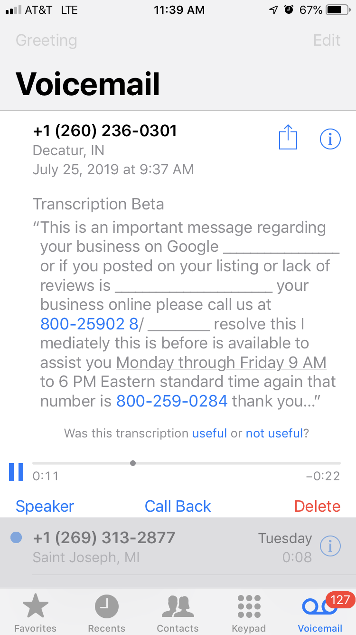
Cyber Security
Phishing Voicemail Message

Slide 61
Cyber Security
STOP

Slide 62
Cyber Security
BREATHE

Slide 63
Cyber Security
THINK

Slide 64
Cyber Security

Slide 65
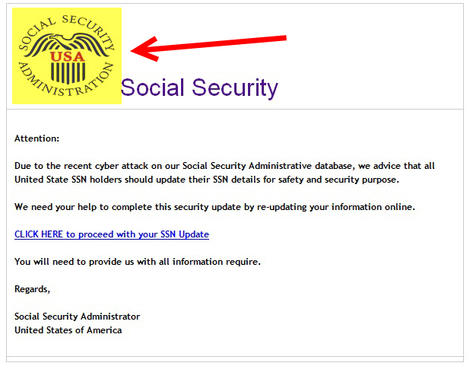
Cyber Security

Slide 66
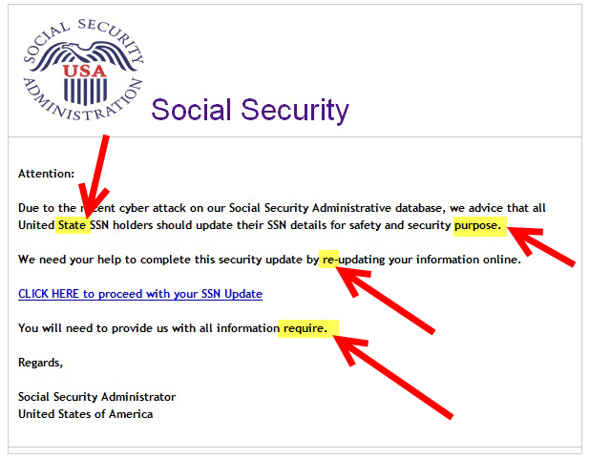
Cyber Security

Slide 67
Cyber Security
ALWAYS hover over any links (text, images and buttons). Is the address correct?
Somewhere on your screen, you will see the URL of the link.

Slide 68
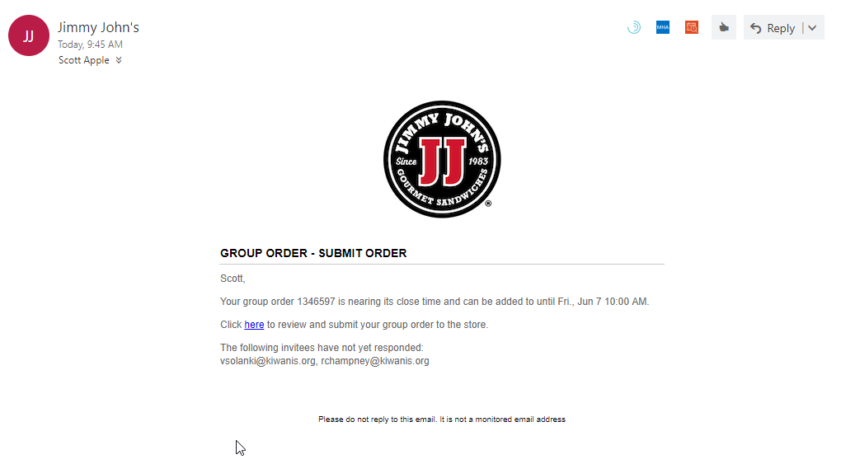
Cyber Security
RED FLAGS – What to look for
Hover over the link. Is the address correct?
https://online.jimmyjohns.com/grouporders/2ae1b17d-01d7-4843-9702-6f8118b6c12c/status/

Slide 69
Cyber Security
https://online.jimmyjohns.com/grouporders/2ae1b17d-01d7-4843-9702-6f8118b6c12c/status/

Slide 70
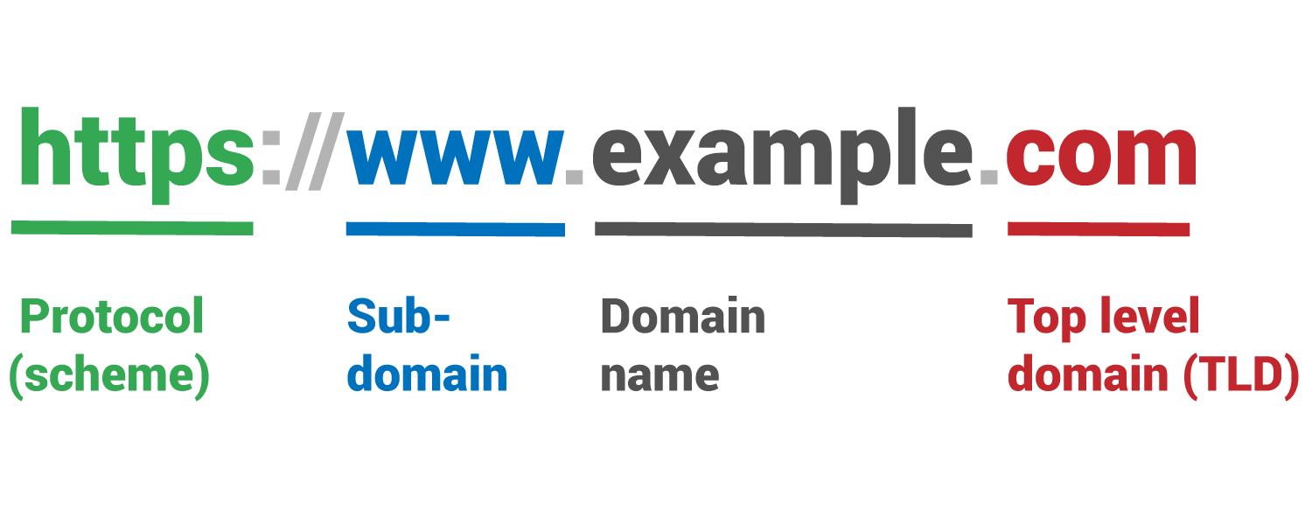
Cyber Security

Slide 71
Cyber Security
https://online.jimmyjohns.com/grouporders/2ae1b17d-01d7-4843-9702-6f8118b6c12c/status/

Slide 72
Cyber Security
RED FLAGS – spoofing links
http://actionelectronics.onmicrosoft.com
Service@Amazen.com
www.Micorsoft.com
www.Youltube.com

Slide 73
Cyber Security
Attachments
ANY attachment you receive that you aren’t expecting is a RED FLAG.
ANY ATTACHMENT

Slide 74
Cyber Security
What do I remember?

Slide 75
Cyber Security
Emotional response – good or bad

Slide 76
Cyber Security
Emotional response – good or bad
STOP – BREATHE – THINK

Slide 77
Cyber Security
Emotional response – good or bad
STOP – BREATHE – THINK
RED FLAGS -

Slide 78
Cyber Security
Emotional response – good or bad
STOP – BREATHE – THINK
RED FLAGS – Anatomy of email

Slide 79
Cyber Security
Emotional response – good or bad
STOP – BREATHE – THINK
RED FLAGS – Anatomy of email
From
To
Subject
Date
Content

Slide 80
Cyber Security
Emotional response – good or bad
STOP – BREATHE – THINK
RED FLAGS – Anatomy of email
From
To
Subject
Date
Content - spelling/grammar, links, attachments

Slide 81
Cyber Security
Common sense approach
Did I initiate this communication?
Do I even have this account?
Is this out of character for the sender?
Do I have another way of confirming this email?

Slide 82
Cyber Security
Common sense approach
When in doubt – DELETE the email.
If it's important, it will come back to you in another form – physical mail and/or phone call.

Slide 83
Cyber Security
Questions?

Slide 84
Cyber Security
Thanks!

